Slide 1
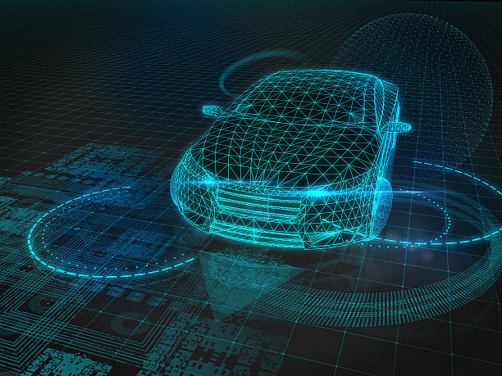
Reinforcement Learning for Safe and Efficient Autonomous Merging Using Highway-Env
Catarina Monteiro – 202105279
Diogo Mendes – 202108102
Gonçalo Brochado - 202106090

Slide 2
Highway - env
In this task, the ego-vehicle starts on a main highway but soon approaches a road junction with incoming vehicles on the access ramp. The agent’s objective is now to maintain a high speed while making room for the vehicles so that they can safely merge in the traffic.
https://highway-env.farama.org/environments/merge/

Slide 3

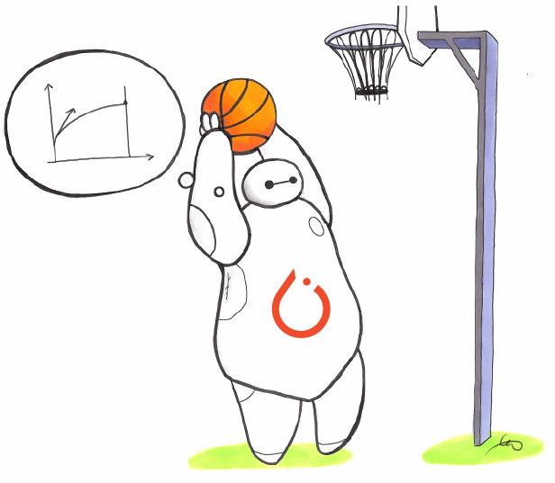
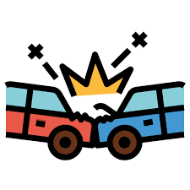

Algorithm – action/observation spaces
PPO Algorithm:
A2C: Multiple workers for efficiency.
TRPO: Trust region for stability.
Objective: Ensure the new policy doesn't deviate too much from the previous one.
Implementation in Stable-Baselines3
PyTorch: Computational efficiency.
Modularity: Easy integration and customization.
Observation Space
TimeToCollision: Time until possible collision with nearby vehicles.
Calculated based on relative speed and location.
Action Space
DiscreteMetaAction: Predefined actions for safe merging:
Accelerate, decelerate, maintain speed, change lanes.

Slide 4
Scenarios
Change Lanes?
Accelerate?
Change Lanes?
What action should the ego vehicle take while on the highway to minimize its impact on other vehicles?
What is the best action for the ego vehicle to take during merging to minimize its effect on other vehicles?
What action should the ego vehicle take while on the highway to minimize its own impact?
Brake?
Brake?
Brake?
What is the optimal merging velocity for the ego vehicle?
What is the minimum gap, highway vehicles should have between them?

Slide 5
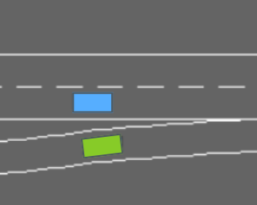

What is the optimal merging velocity for the ego vehicle?
Baseline Rewards: Applied consistently, with speed interval modifications.
Collision Reward: -1 (Penalty for collision)
Right Lane Reward: +0.1 (Positive for staying in the right lane)
High Speed Reward: +0.2 (Incentive for high speed)
Merging Speed Penalty: -5 (Penalty for improper merging speed)
Lane Change Penalty: -0.05 (Small penalty for lane changes)
Custom Environment

Slide 6
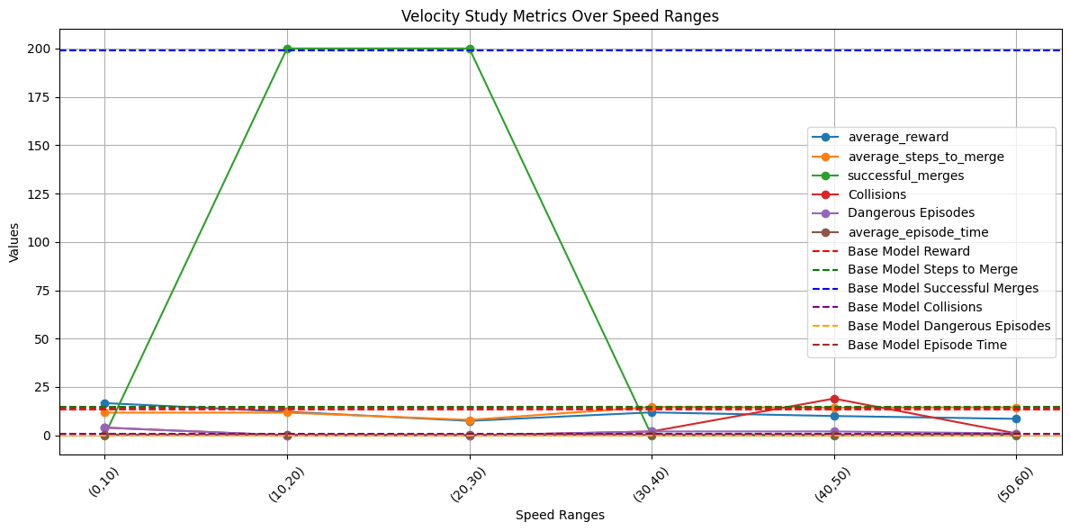
Results

Slide 7
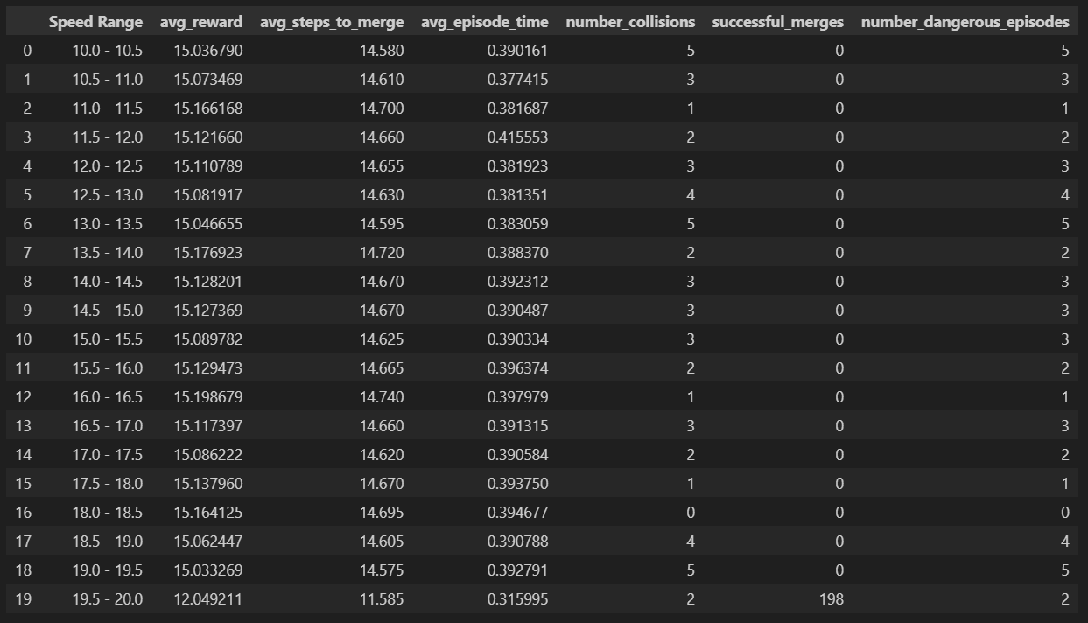
Narrowing the (10,20) interval

Slide 8
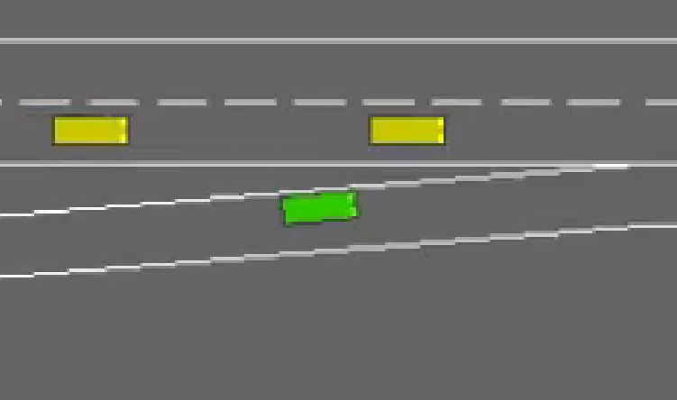
What is the minimum gap, highway vehicles should have between them?
Baseline Rewards: Applied consistently, with speed interval modifications.
Collision Reward: -1 (Penalty for collision)
Right Lane Reward: +0.1 (Positive for staying in the right lane)
High Speed Reward: +0.2 (Incentive for high speed)
Merging Speed Penalty: -5 (Penalty for improper merging speed)
Lane Change Penalty: -0.05 (Small penalty for lane changes)
MUDARRRRRR POR DE ACORDO COM O RELATORIO
Custom Environment

Slide 9
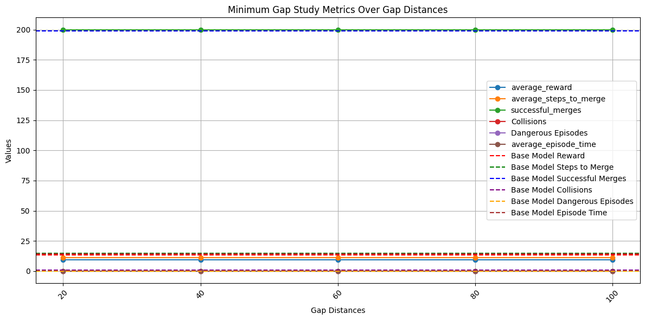
Results

Slide 10
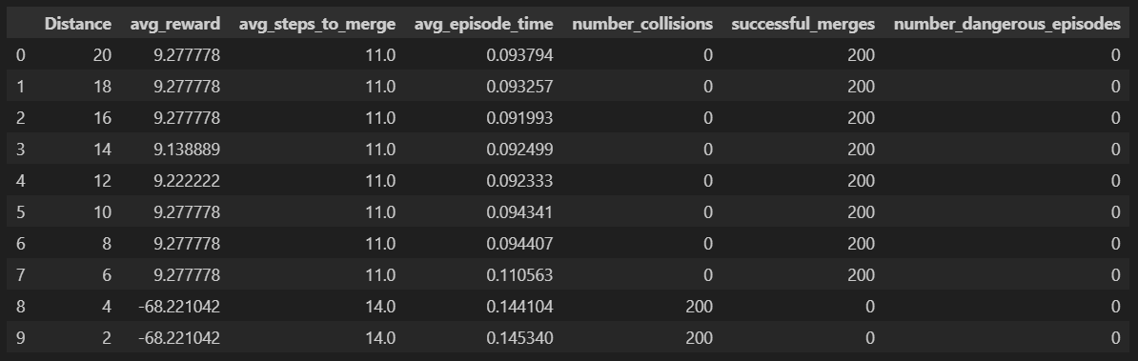
Narrowing the smallest interval

Slide 11

What is the best action for the ego vehicle to take during merging to minimize its effect on other vehicles?
Configuration | Braking | Accelerating
Balanced Values | Braking Bonus: 5.0, Braking Penalty: 5.0 Yielding Bonus: 6.0, Yielding Penalty: 6.0 Influence Penalty: 15.0 | Influence Penalty: -5, Merging Bonus: 3, Merging Penalty: 2
Ego Lets Go Ahead | Braking Bonus: 3.0, Braking Penalty: 3.0 Yielding Bonus: 12.0, Yielding Penalty: 6.0 Influence Penalty: 15.0 | Influence Penalty: -5, Merging Bonus: 3, Merging Penalty: 2
Severe Punisment on Influence | Braking Bonus: 3.0, Braking Penalty: 3.0 Yielding Bonus: 6.0, Yielding Penalty: 6.0 Influence Penalty: 30.0 | Influence Penalty: -10, Merging Bonus: 1.5, Merging Penalty: 2
Safe Behaviour | Braking Bonus: 3.0, Braking Penalty: 3.0 Yielding Bonus: 12.0, Yielding Penalty: 6.0 Influence Penalty: 30.0 | Influence Penalty: -10, Merging Bonus: 1.5, Merging Penalty: 4
Agressive Behaviour | Braking Bonus: 12.0, Braking Penalty: 3.0 Yielding Bonus: 1.5, Yielding Penalty: 6.0 Influence Penalty: 15.0 | Influence Penalty: -5, Merging Bonus: 1.5, Merging Penalty: 4
Custom Environment

Slide 12
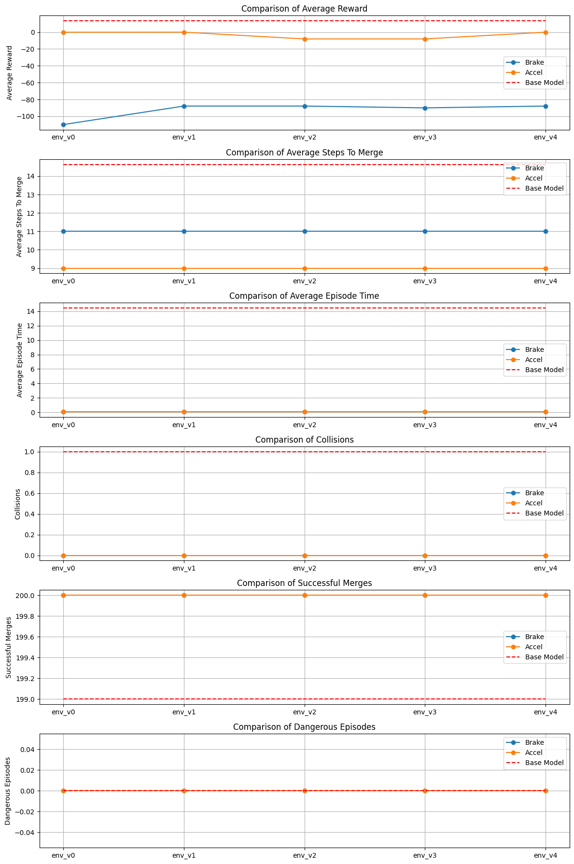
results

Slide 13

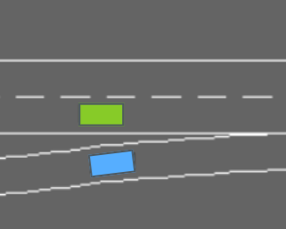
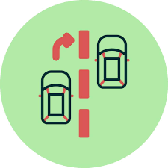
What action should the ego vehicle take while on the highway to minimize its own impact?
Fixed Rewards:
High Speed: +1
Lane Change: -5
Right Lane: +3
Additional Reward:
Braking: +5
Fixed Rewards:
High Speed: +6
Right Lane: +3
Additional Rewards/Penalties:
Lane Change Near Merging Vehicle: +40
Overtaking: +25
Following Behind Merging Vehicle: -20
Custom Environment

Slide 14
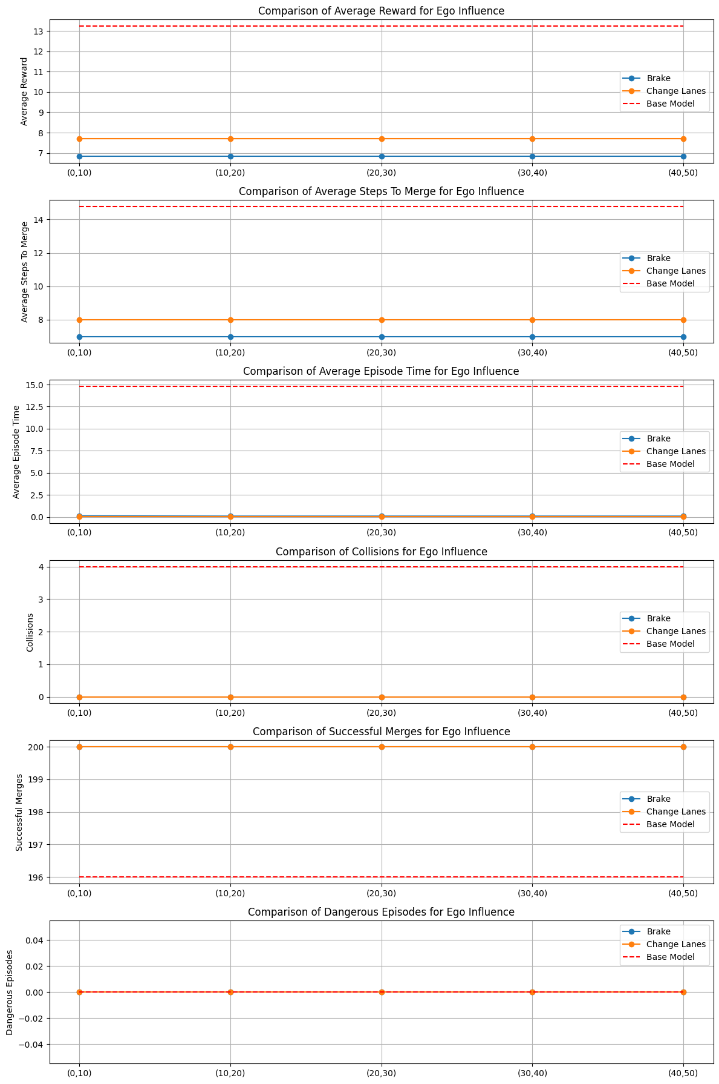
results

Slide 15
What action should the ego vehicle take while on the highway to minimize its impact on other vehicles?
Fixed Rewards:
High Speed: +6
Right Lane: +3
Additional Rewards/Penalties:
Braking: +5
Influence Penalty: -5
Fixed Rewards:
High Speed: +6
Right Lane: +3
Additional Rewards/Penalties:
Lane Change Near Merging Vehicle: +40
Overtaking: +25
Following Behind Merging Vehicle: -20
Influence Penalty: -15
Custom Environment

Slide 16
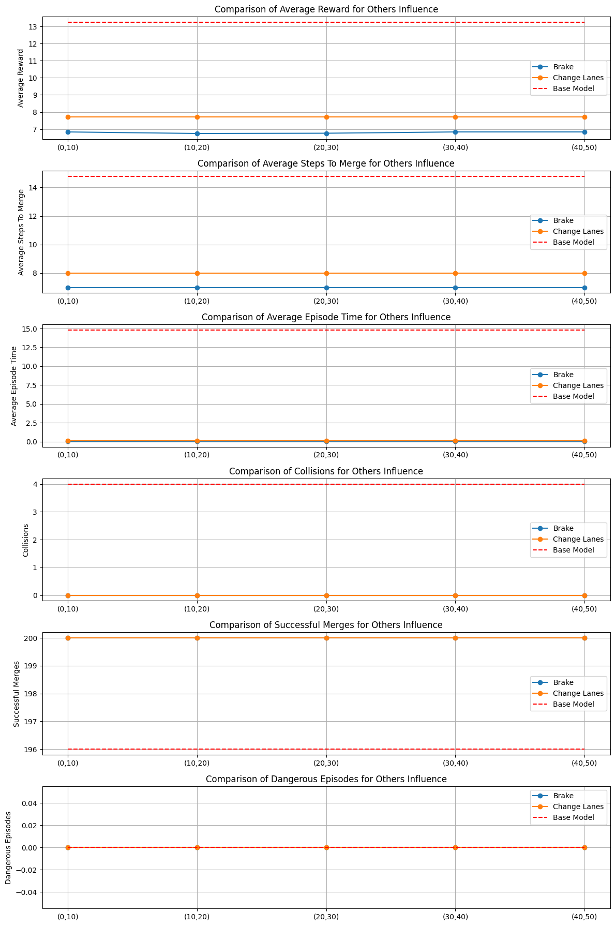
results

Slide 17
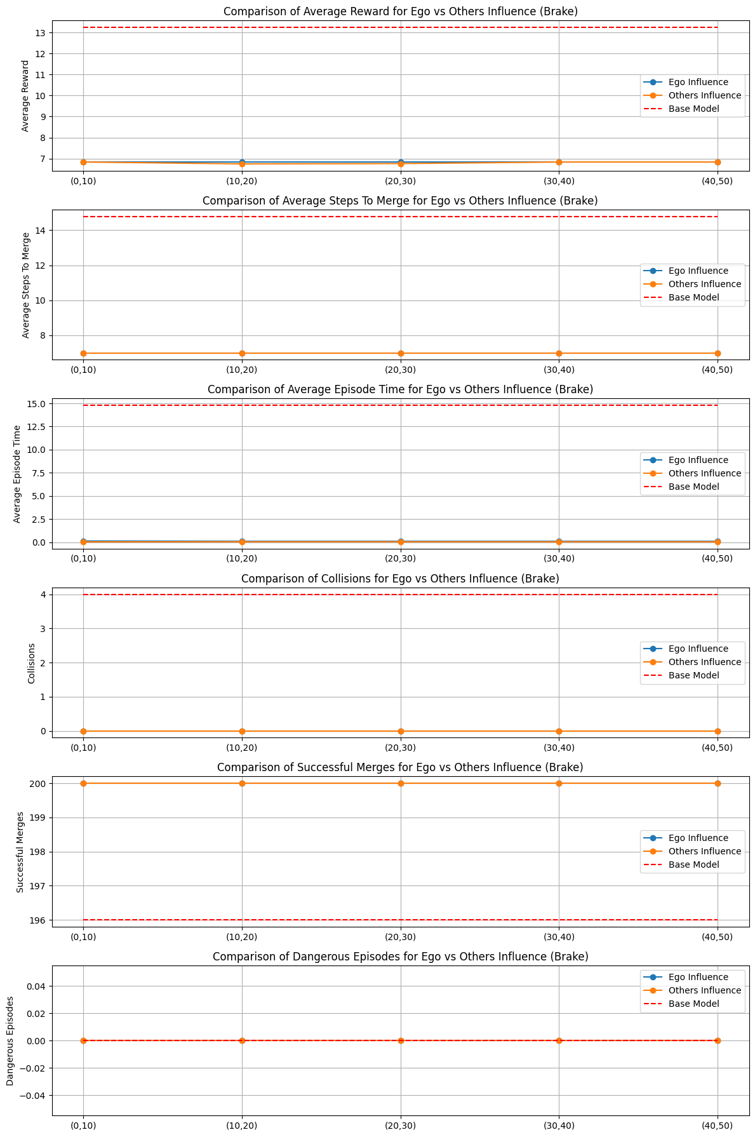
Brake – is it better being “selfish” or “altruistic”?

Slide 18
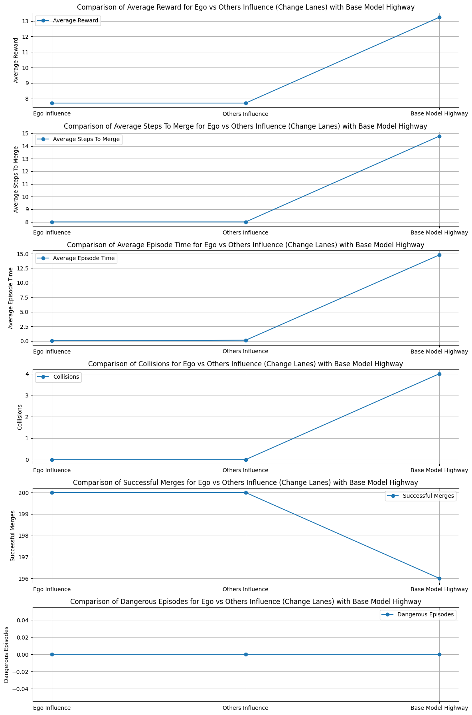
Change lanes – is it better being “selfish” or “altruistic”

Slide 19
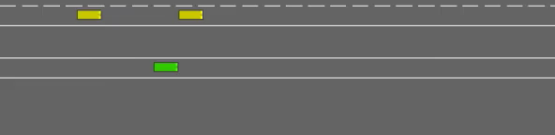
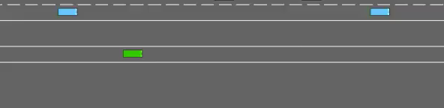


Demonstration vídeos – Ego merging
Minimum Gap – distance = 20
Velocity Study – Speed Range = [10,20]
Brake
Accelerate

Slide 20


Demonstration vídeos – Ego On the Highway
Ego’s Influence – Brake (braking distance (40,50)
Ego’s Influence – Change Lanes
Other’s Influence – Brake (braking distance (40,50)
Other’s Influence – Change Lanes

